Slide 1
Is there a site effect?
Randomization was stratified by site and sex to avoid confound from inter-site differences

Slide 2
Day 2 Lesion Volume Differs by Site

Slide 3
mTT Descriptive statistics by site, Day 2
Variable | Site: AG (n = 120) | Site: IW (n = 167) | Site: JH (n = 132) | Site: MG (n = 148) | Site: UT (n = 151) | Site: YL (n = 152)
Volume Lesion
Mean ± SD | 26.97 ± 32.94 | 20.19 ± 20.24 | 12.14 ± 16.14 | 43.29 ± 27.66 | 47.52 ± 39.50 | 33.17 ± 27.66
Median (Q25% ; Q75%) | 13.82 (3.45 ; 43.62) | 13.91 (5.82 ; 28.42) | 7.49 (1.33 ; 15.13) | 45.50 (22.48 ; 60.49) | 54.18 (2.33 ; 77.63) | 31.72 (7.59 ; 52.69)
Median (Min ; Max) | 13.82 (0.00 ; 140.39) | 13.91 (0.00 ; 93.31) | 7.49 (0.00 ; 89.85) | 45.50 (0.00 ; 130.40) | 54.18 (0.00 ; 147.51) | 31.72 (0.00 ; 132.32)
Missing | 17 | 8 | 10 | 15 | 50 | 28
Volume CSF
Mean ± SD | 8.50 ± 5.30 | 5.07 ± 2.22 | 8.35 ± 3.11 | 7.98 ± 2.35 | 7.68 ± 4.96 | 6.24 ± 5.92
Median (Q25% ; Q75%) | 6.86 (4.28 ; 11.04) | 4.68 (3.66 ; 6.10) | 7.89 (6.58 ; 9.84) | 7.64 (6.23 ; 9.32) | 6.35 (5.04 ; 8.84) | 5.13 (3.65 ; 6.77)
Median (Min ; Max) | 6.86 (0.15 ; 25.66) | 4.68 (0.57 ; 16.86) | 7.89 (1.03 ; 21.61) | 7.64 (4.06 ; 20.67) | 6.35 (1.98 ; 32.85) | 5.13 (0.25 ; 61.05)
Missing | 17 | 8 | 10 | 15 | 50 | 28
Volume Tissue
Mean ± SD | 343.85 ± 28.55 | 321.21 ± 17.89 | 351.74 ± 16.78 | 333.55 ± 25.39 | 319.01 ± 33.85 | 313.87 ± 29.86
Median (Q25% ; Q75%) | 353.23 (331.72 ; 363.04) | 324.72 (313.52 ; 332.77) | 354.67 (342.48 ; 364.35) | 332.38 (319.35 ; 349.83) | 316.06 (293.97 ; 353.00) | 314.63 (296.79 ; 333.99)
Median (Min ; Max) | 353.23 (239.90 ; 382.91) | 324.72 (265.85 ; 356.89) | 354.67 (287.80 ; 376.31) | 332.38 (241.74 ; 387.02) | 316.06 (221.62 ; 393.28) | 314.63 (219.34 ; 374.54)
Missing | 17 | 8 | 10 | 15 | 50 | 28
Volume Index = Ispi brain/total brain
Mean ± SD | 0.12 ± 0.18 | 0.06 ± 0.11 | 0.03 ± 0.07 | 0.17 ± 0.14 | 0.22 ± 0.21 | 0.13 ± 0.15
Median (Q25% ; Q75%) | 0.04 (0.01 ; 0.17) | 0.03 (-0.01 ; 0.08) | 0.01 (-0.01 ; 0.04) | 0.17 (0.07 ; 0.24) | 0.22 (0.02 ; 0.35) | 0.11 (0.03 ; 0.19)
Median (Min ; Max) | 0.04 (-0.06 ; 0.89) | 0.03 (-0.11 ; 0.51) | 0.01 (-0.05 ; 0.43) | 0.17 (-0.06 ; 0.82) | 0.22 (-0.04 ; 1.02) | 0.11 (-0.08 ; 0.84)
Missing | 17 | 8 | 10 | 15 | 50 | 28

Slide 4
mITT Descriptive statistics by site, Day 30
Variable | Site: AG (n = 120) | Site: IW (n = 167) | Site: JH (n = 132) | Site: MG (n = 148) | Site: UT (n = 151) | Site: YL (n = 152)
Volume Lesion
Mean ± SD | 2.14 ± 1.08 | 0.07 ± 0.64 | 0.62 ± 1.05 | 0.61 ± 2.98 | 0.01 ± 0.03 | 0.54 ± 1.27
Median (Q25% ; Q75%) | 2.03 (1.40 ; 2.94) | 0.00 (0.00 ; 0.00) | 0.31 (0.00 ; 0.74) | 0.00 (0.00 ; 0.32) | 0.00 (0.00 ; 0.00) | 0.00 (0.00 ; 0.26)
Median (Min ; Max) | 2.03 (0.00 ; 5.24) | 0.00 (0.00 ; 6.60) | 0.31 (0.00 ; 6.20) | 0.00 (0.00 ; 32.60) | 0.00 (0.00 ; 0.18) | 0.00 (0.00 ; 6.79)
Missing | 39 | 59 | 29 | 23 | 73 | 76
Volume CSF
Mean ± SD | 5.38 ± 2.19 | 6.56 ± 2.64 | 8.40 ± 4.01 | 13.09 ± 4.79 | 12.04 ± 6.65 | 7.88 ± 8.71
Median (Q25% ; Q75%) | 5.12 (3.99 ; 6.22) | 6.05 (5.11 ; 7.49) | 8.08 (6.60 ; 9.82) | 11.88 (10.17 ; 15.23) | 10.26 (7.62 ; 13.97) | 6.44 (4.60 ; 8.36)
Median (Min ; Max) | 5.12 (1.76 ; 12.92) | 6.05 (2.78 ; 20.57) | 8.08 (0.70 ; 30.93) | 11.88 (5.27 ; 39.89) | 10.26 (4.71 ; 37.73) | 6.44 (2.59 ; 78.15)
Missing | 39 | 59 | 29 | 23 | 73 | 76
Volume Tissue
Mean ± SD | 355.07 ± 11.57 | 326.81 ± 10.27 | 360.80 ± 10.80 | 354.49 ± 14.58 | 347.36 ± 16.78 | 333.61 ± 17.40
Median (Q25% ; Q75%) | 357.28 (347.68 ; 362.77) | 328.67 (319.89 ; 333.47) | 361.35 (354.26 ; 369.85) | 356.02 (346.43 ; 361.90) | 348.62 (334.05 ; 360.19) | 333.72 (323.70 ; 345.40)
Median (Min ; Max) | 357.28 (311.45 ; 377.11) | 328.67 (291.46 ; 353.52) | 361.35 (319.52 ; 377.70) | 356.02 (298.44 ; 385.39) | 348.62 (306.17 ; 389.55) | 333.72 (281.61 ; 370.44)
Missing | 39 | 59 | 29 | 23 | 73 | 76
Volume Index = Ispi brain/total brain
Mean ± SD | 0.08 ± 0.05 | 0.08 ± 0.06 | 0.02 ± 0.04 | 0.10 ± 0.06 | 0.10 ± 0.08 | 0.10 ± 0.07
Median (Q25% ; Q75%) | 0.07 (0.04 ; 0.12) | 0.07 (0.04 ; 0.11) | 0.02 (-0.01 ; 0.04) | 0.11 (0.06 ; 0.13) | 0.10 (0.03 ; 0.17) | 0.09 (0.05 ; 0.13)
Median (Min ; Max) | 0.07 (0.01 ; 0.20) | 0.07 (-0.02 ; 0.29) | 0.02 (-0.03 ; 0.14) | 0.11 (-0.10 ; 0.27) | 0.10 (-0.01 ; 0.28) | 0.09 (-0.06 ; 0.33)
Missing | 39 | 59 | 29 | 23 | 73 | 76

Slide 5
Stratified randomization seeks to balance enrollment across study sites. Because treatment assignment is balanced across sites, inter-site variation should be minimized, and global treatment effects should remain independent of site-to-site variation.

Slide 6
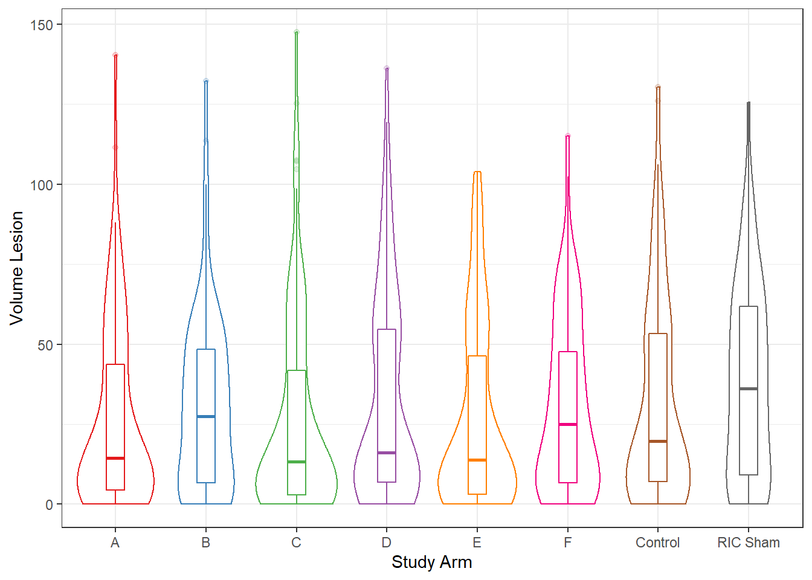
mITT Day 2 Volume Lesion

Slide 7
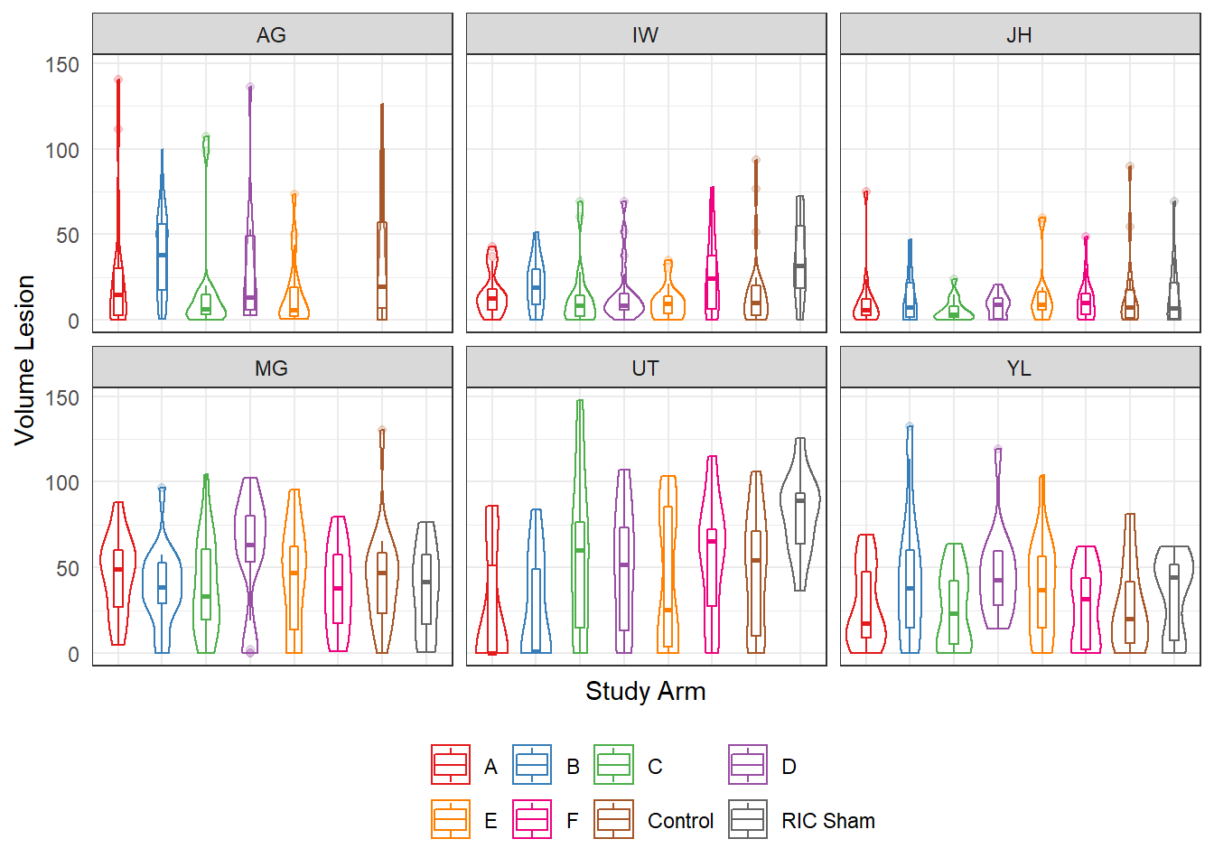
mITT Day 2 Volume Lesion

Slide 8
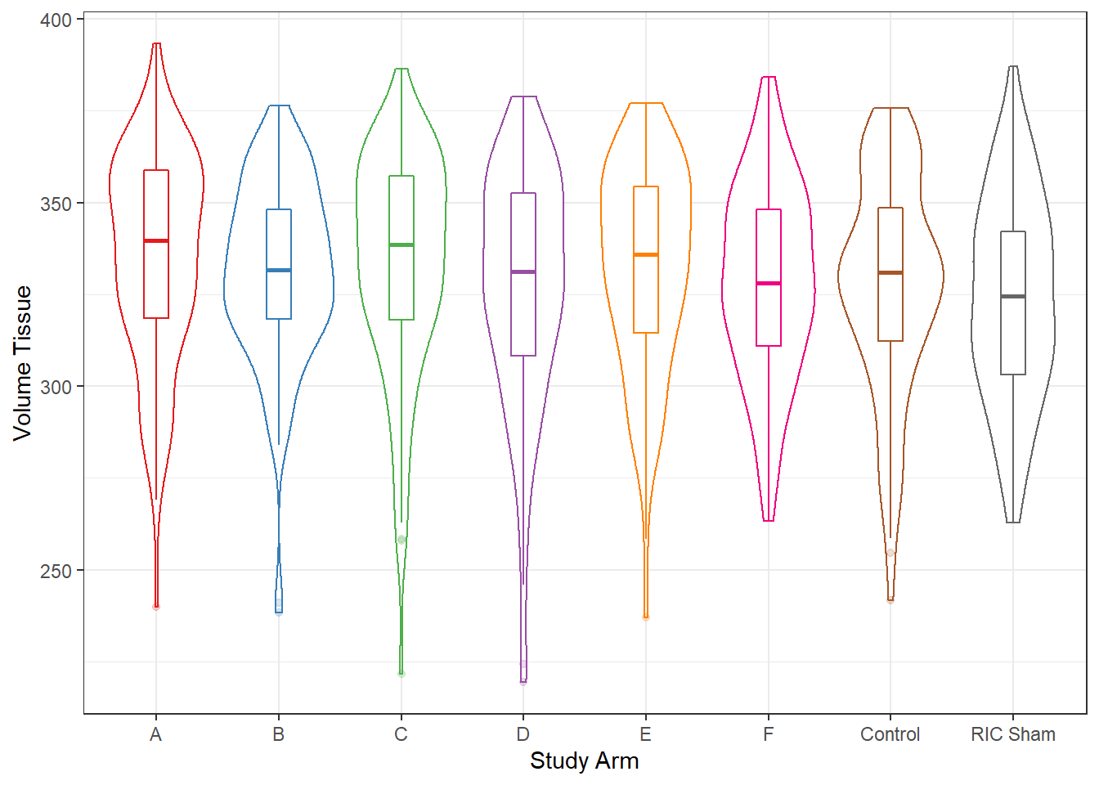
mITT Day 2 Volume Tissue

Slide 9
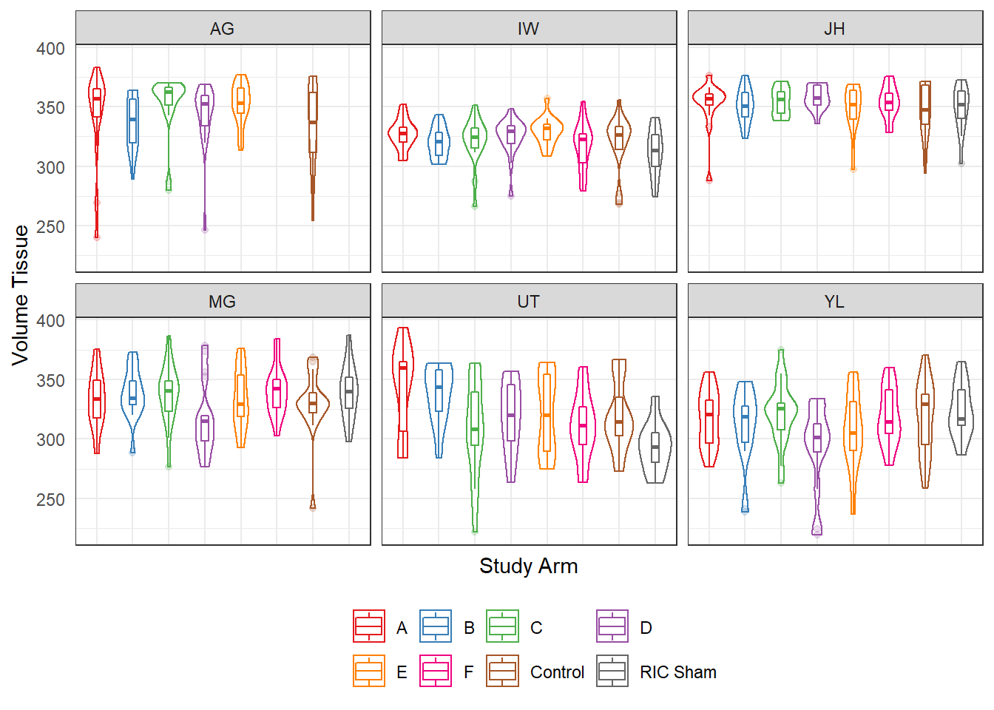
mITT Day 2 Volume Tissue

Slide 10
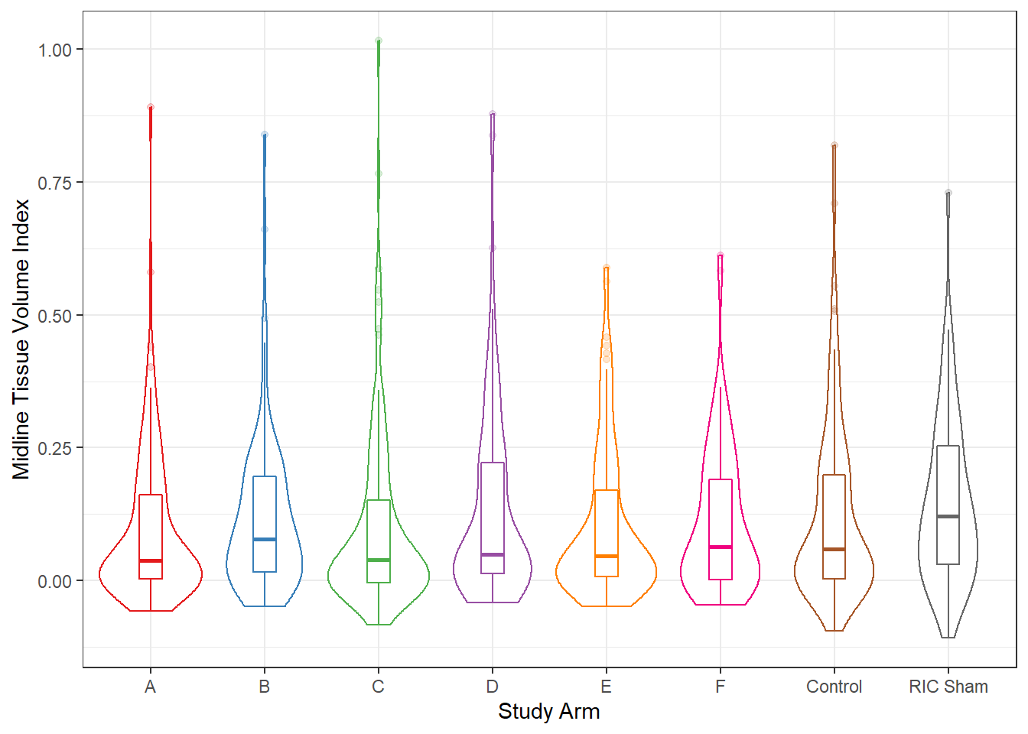
mITT Day 2 Tissue Volume Index

Slide 11
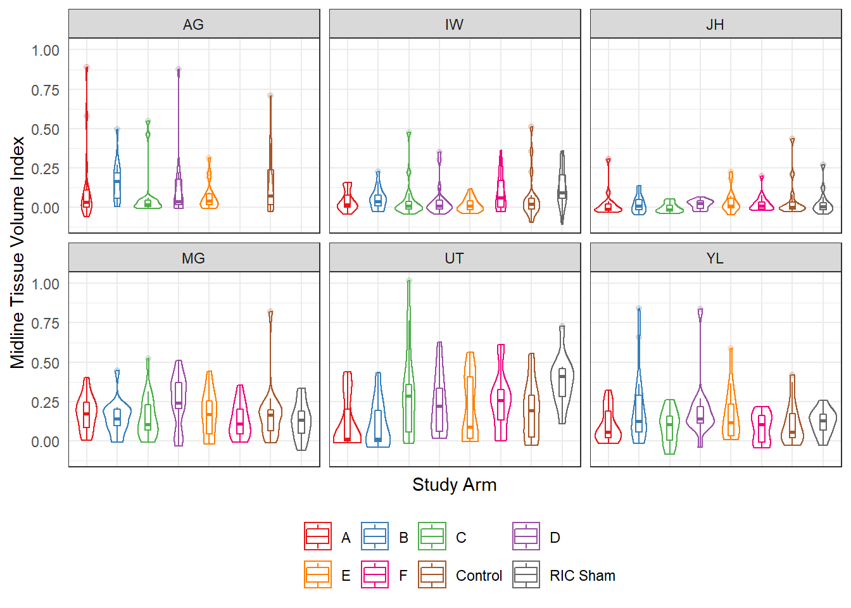
mITT Day 2 Tissue Volume Index

Slide 12
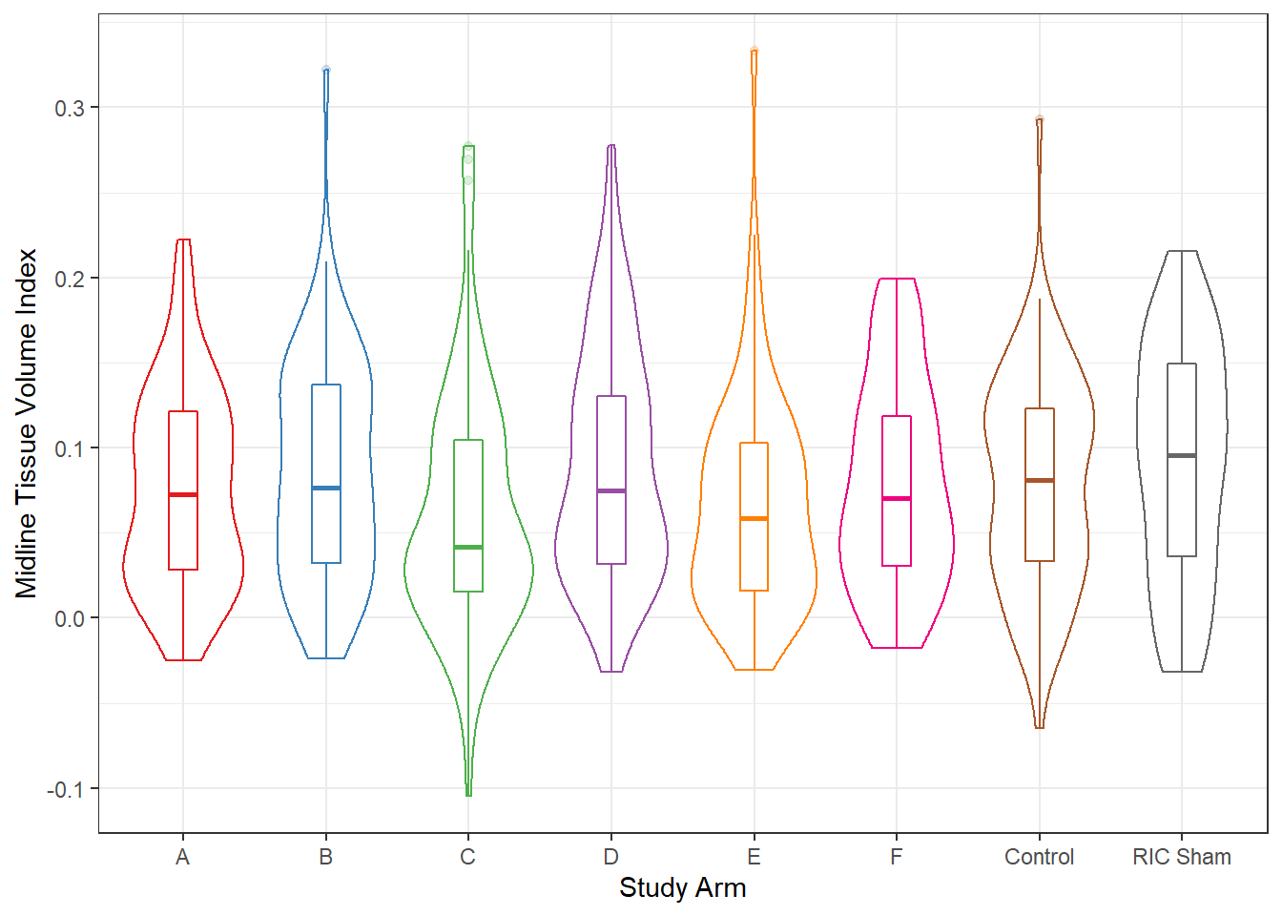
mITT Day 30 Tissue Volume Index

Slide 13
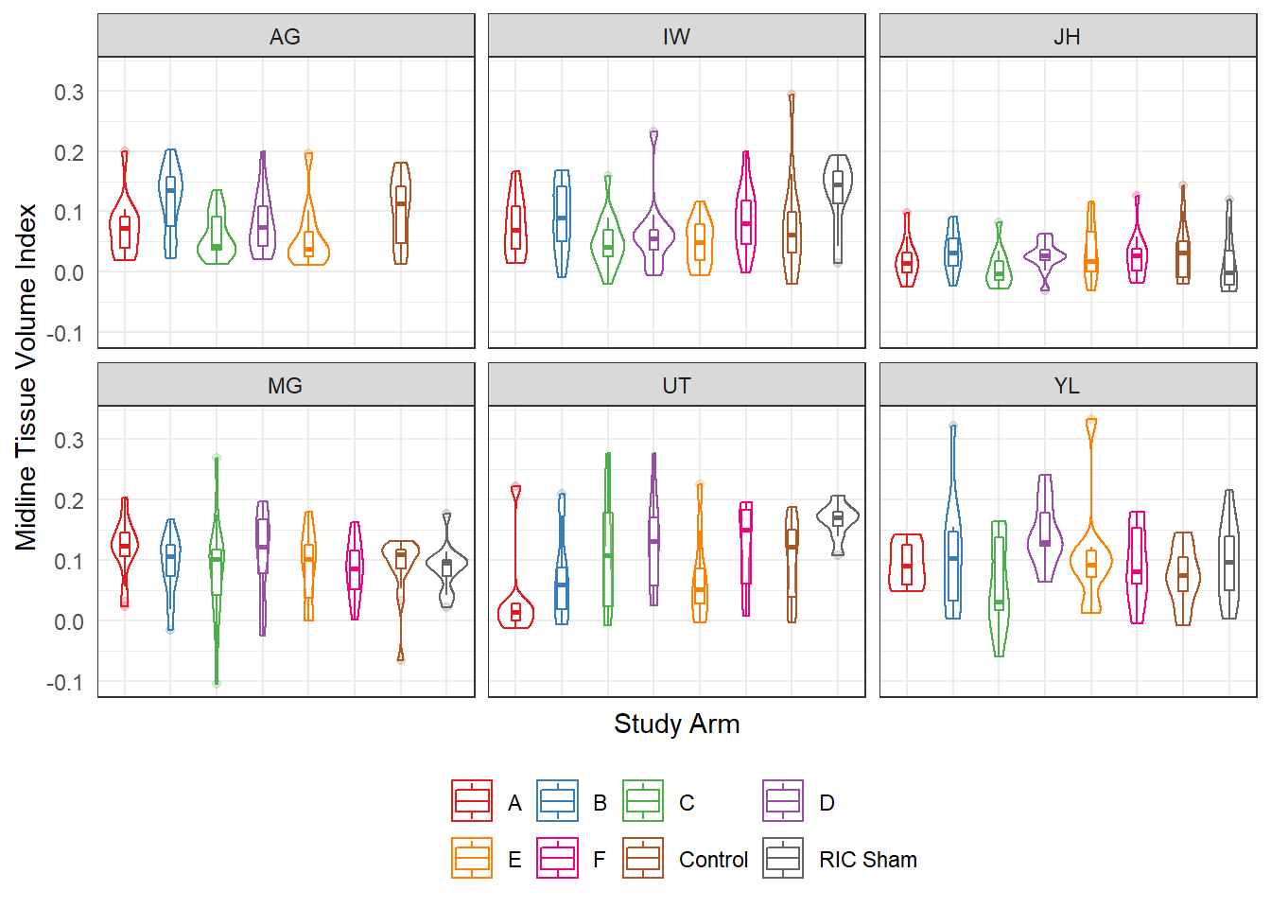
mITT Day 2 Tissue Volume Index

Slide 14
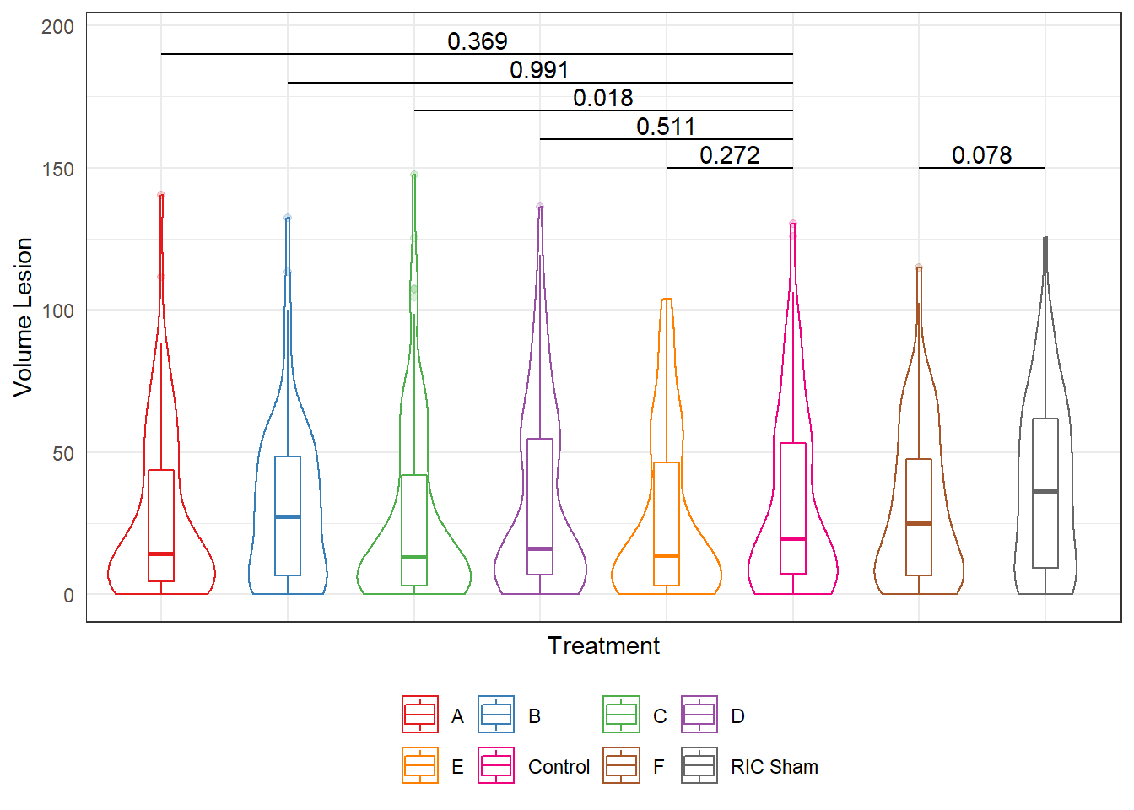
mITT Day 2 Volume Lesion

Slide 15
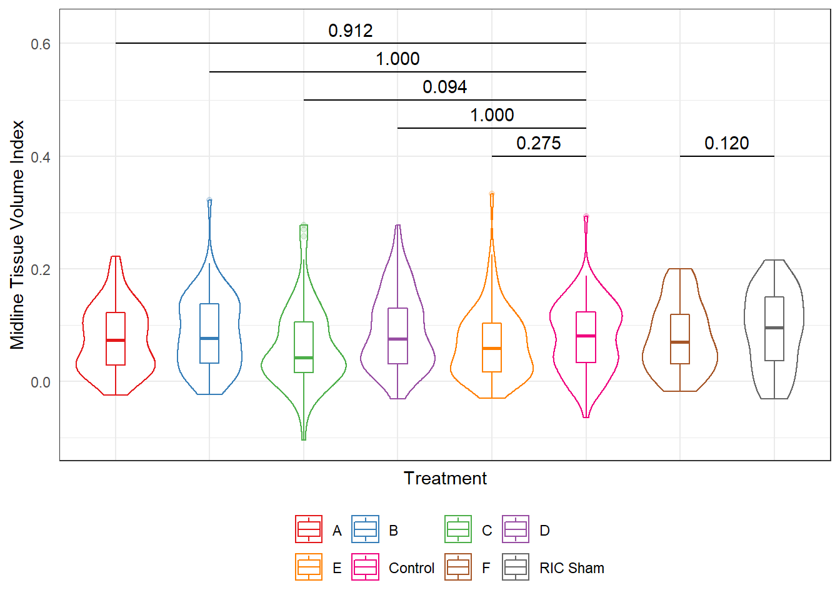
mITT Day 30 Tissue Loss Index

Slide 16
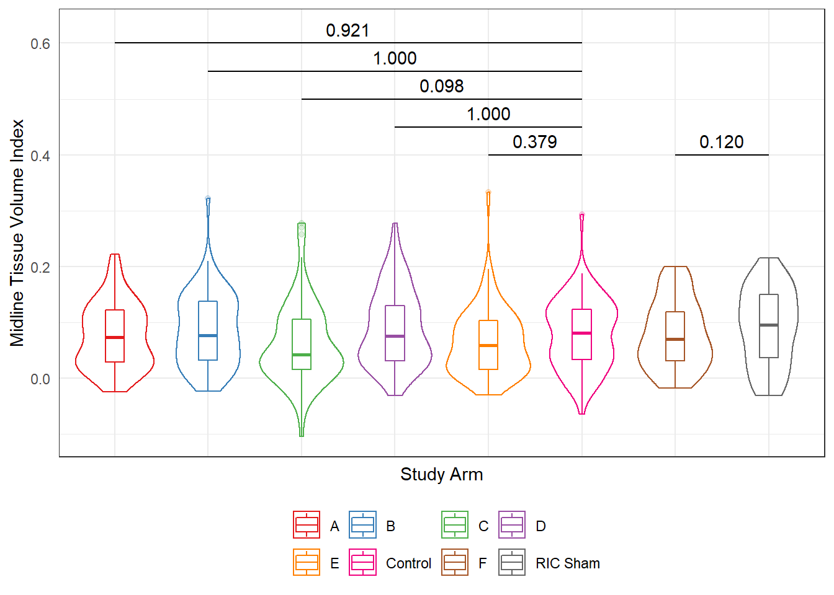
PP Day 30 Tissue Volume Loss with Imputed Missing Values

Slide 17
Alternative Corner Test Regression Models mITT, Beta Model, no imputation
Alternative Corner test => sex, asleep/awake, treatment, site, baseline corner
Parametric Model:
Test site X treatment interaction terms:
IP/IV site x treatment p=0.601
RIC p=0.881

Slide 18
Corner Test Regression Models PP, Beta Model, no imputation
Corner test => sex, asleep/awake, treatment, site, baseline corner
Parametric Model:
Test site X treatment interaction terms:
IP/IV site x treatment p=0.103
RIC p=0.538
Non-parametric Model
IP/IV site x treatment p=0.916

Slide 19
There is no evidence of a site x treatment effect
Treatment andomization was stratified by site
Sites differed in lesion volume
Treatments did not differ in lesion volume
Multi-variable regression modeling with the Corner test failed to confirm a treatment x site interaction

